Slide 1
EE207
Electronic Devices and Circuits
S. Lodha
Lecture 1: Crystal Structure
Supplementary Slides
Acknowledgements:
Class handouts, Farhan Rana, Cornell University
Advanced Semiconductor Fundamentals, R. Pierret, Purdue University
Souvik Mahapatra, IIT Bombay

Slide 2
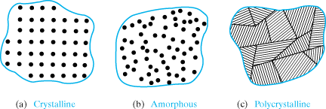
Types of Solids
A crystal has long range order, polycrystalline material only short range order and an amorphous material no order.
16/07/2018
S. Lodha

Slide 3
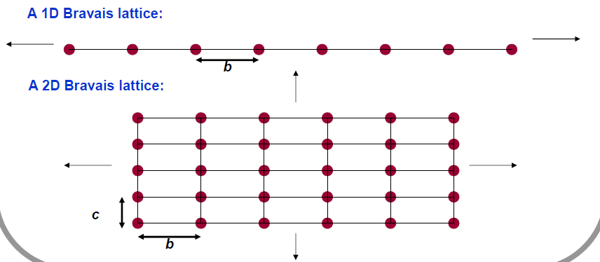
Bravais Lattices
Infinite arrangement of points in space such that the lattice looks exactly the same when viewed from any lattice point
16/07/2018
S. Lodha

Slide 4
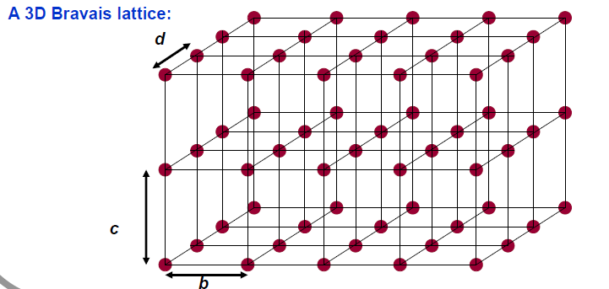
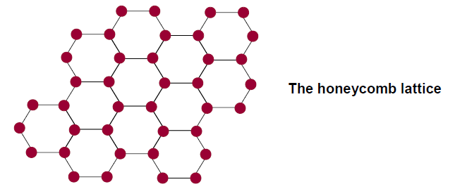
Bravais Lattices
Not a Bravais Lattice:
16/07/2018
S. Lodha

Slide 5
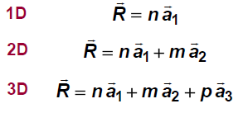
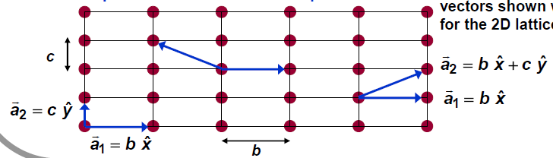
Primitive Lattice Vectors
n, m, p are integers
Non parallel (2D), not in the same plane (3D)
Choice of primitive vectors is not unique
16/07/2018
S. Lodha

Slide 6
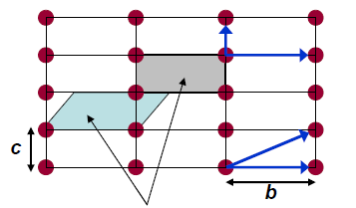
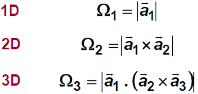
Primitive Cell
Two different choices of primitive cells
Smallest region (Minimum volume/area/length) which when translated by all different lattice vectors can “tile” or “cover” the entire lattice without overlapping or creating voids
Not unique
Contains one lattice point
Length, area, volume are independent of choice of primitive vectors / cell
16/07/2018
S. Lodha

Slide 7
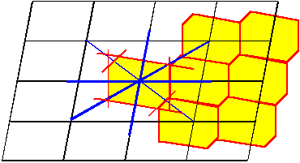
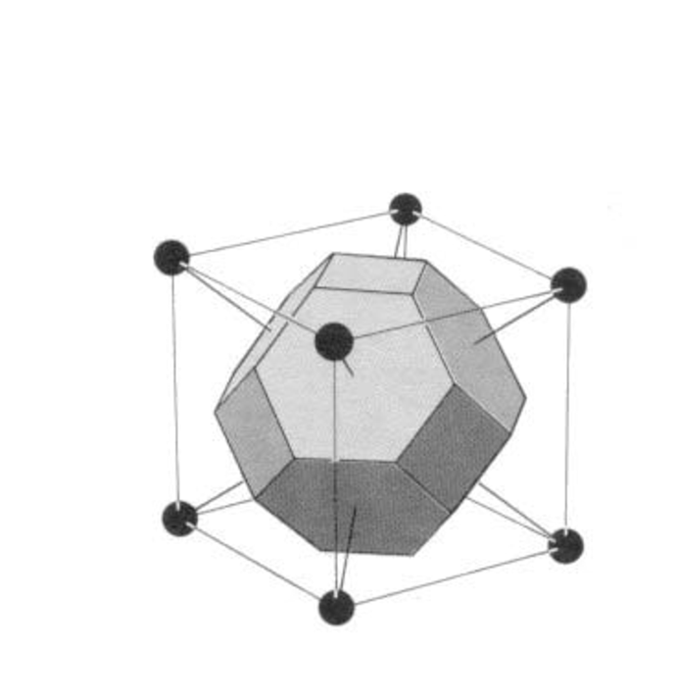
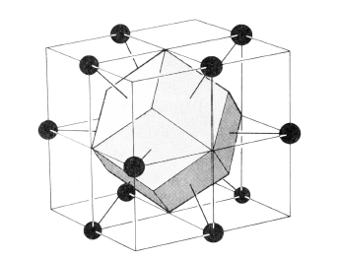
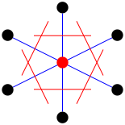
Wigner-Seitz Primitive Cell
BCC lattice
FCC lattice
Locus of points in space around a lattice point that are closer to that lattice point than to any of the other lattice points
16/07/2018
S. Lodha

Slide 8
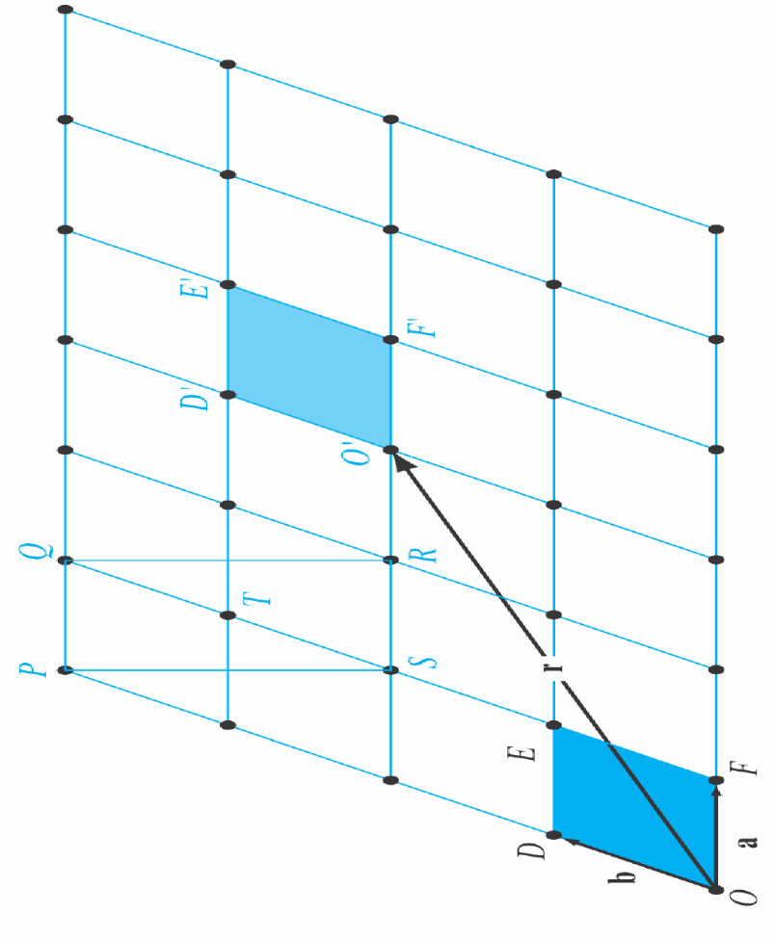
Unit Cell
ODEF is a primitive cell
PQRS is a UNIT cell (center rectangle)
  Sometimes a better choice for reasons of symmetry and orthogonality
  It can also generate the entire lattice, but not primitive
    Contains effectively 2 lattice points
16/07/2018
S. Lodha

Slide 9
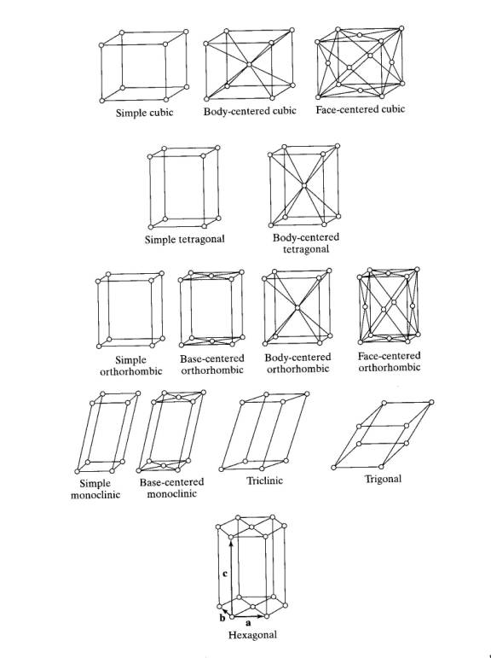
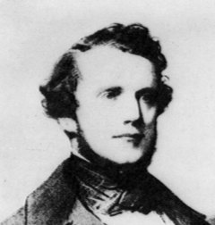
Bravais Lattices (3D)
14 Unique Unit Cells
Auguste Bravais (1811-1863)
16/07/2018
S. Lodha

Slide 10
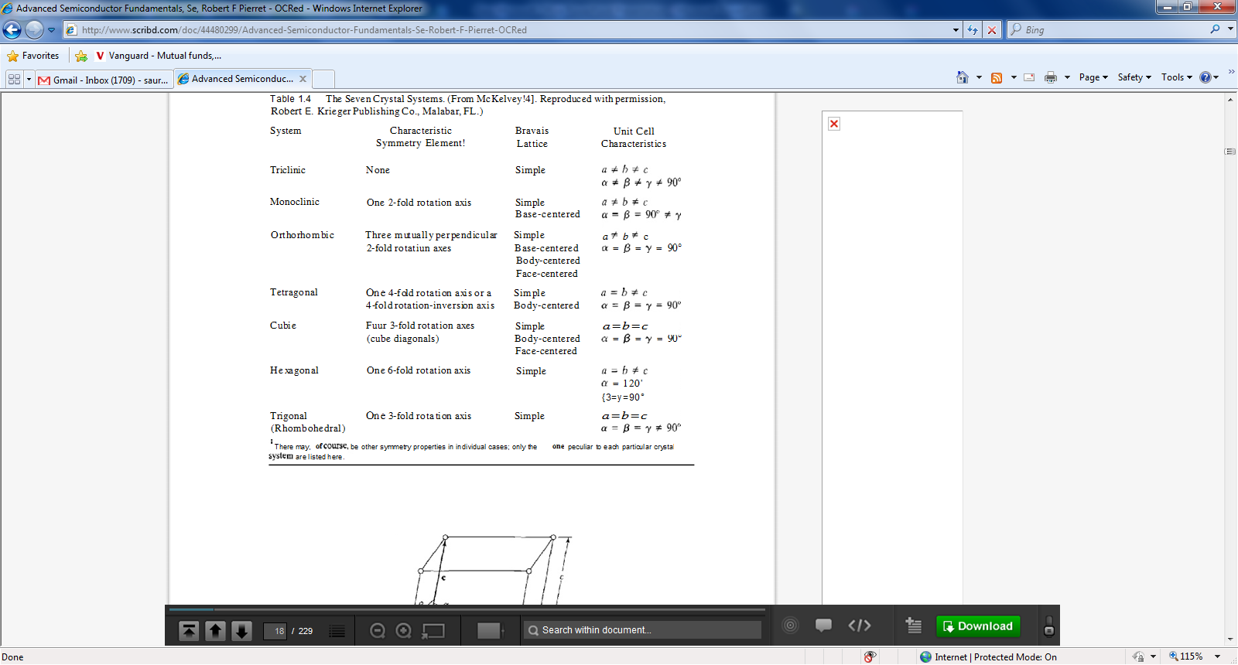
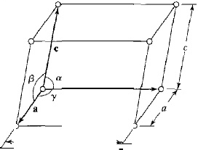
Seven Crystal Systems
16/07/2018
S. Lodha

Slide 11
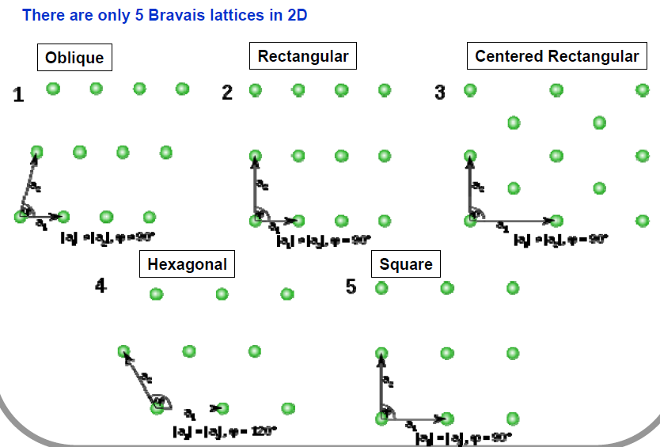
Bravais Lattices (2D)
16/07/2018
S. Lodha

Slide 12



Cubic Crystal system
Cubic: Simple; Body Centered; Face Centered
Only simple cubic is a primitive cell, BCC and FCC are unit cells (not primitive)
16/07/2018
S. Lodha

Slide 13
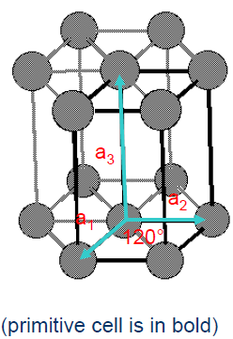
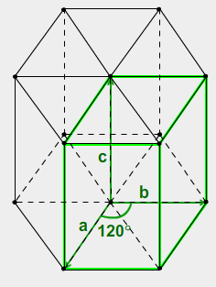
Hexagonal crystal system
Stacked 2D triangular nets one above the other
Direction of stacking is called c-axis
16/07/2018
S. Lodha

Slide 14
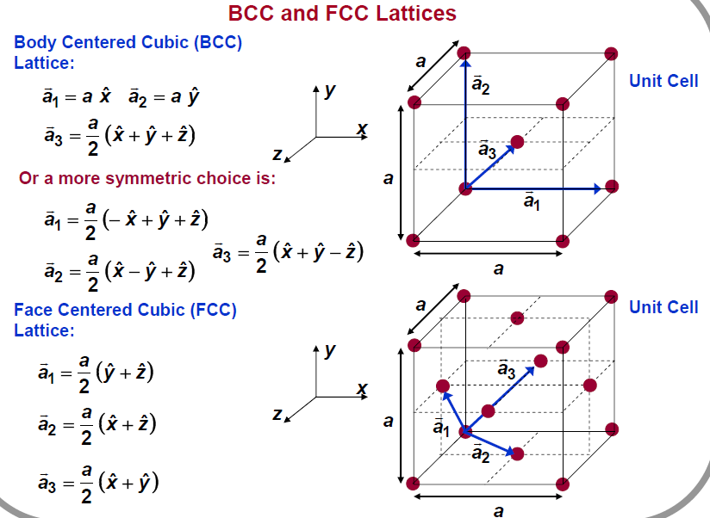
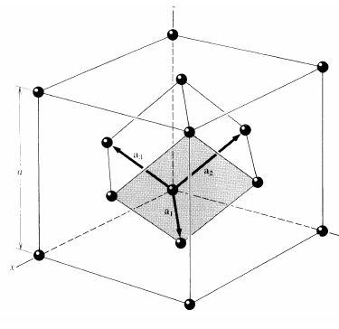
Primitive Lattice Vectors
16/07/2018
S. Lodha

Slide 15
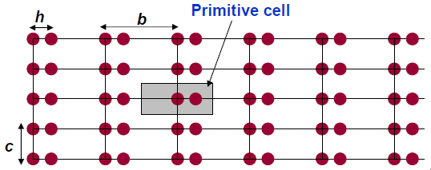

Crystal Structure
Crystal = Lattice + Basis
Lattice: Set of points
Basis: Set of atoms corresponding to each lattice point
Not a Bravais Lattice
2 atoms (basis) per lattice point
Basis vectors: location of basis atoms w.r.t underlying lattice point
16/07/2018
S. Lodha

Slide 16
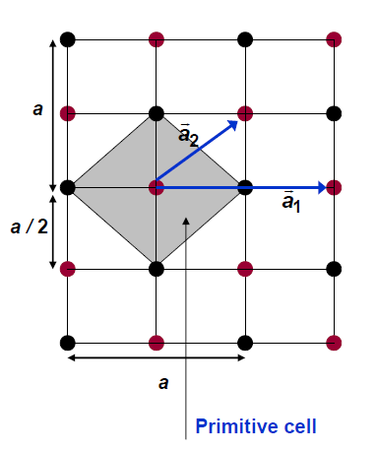
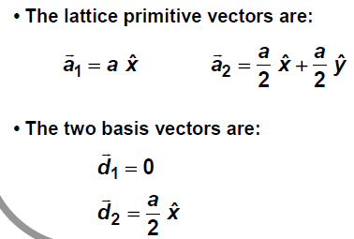
Lattice with basis
Red= Lattice points
Red and black= Basis atoms
16/07/2018
S. Lodha

Slide 17
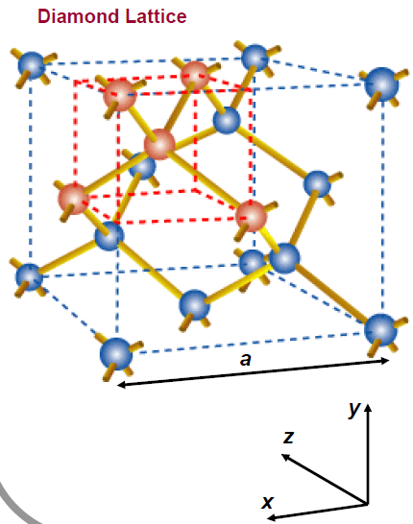
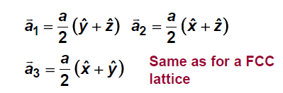

Si, Ge, C Crystal structure
2 Interleaved FCC with origin shifted by ¼, ¼, ¼ along body diagonal
2-atom basis
Primitive Lattice Vectors
Basis vectors
16/07/2018
S. Lodha

Slide 18
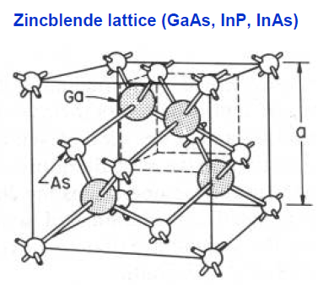
GaAs crystal structure
Similar to Si, except that the two atoms of the basis set are different
16/07/2018
S. Lodha

Slide 19
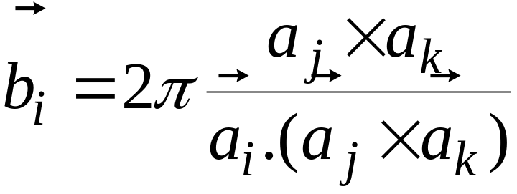
Reciprocal lattice
Crystal lattice – in real space
Reciprocal lattice – in momentum (k) space
Reciprocal lattice unit vectors
Real lattice unit vectors
Reciprocal lattice of SC is SC, of FCC is BCC and of BCC is FCC
16/07/2018
S. Lodha

Slide 20
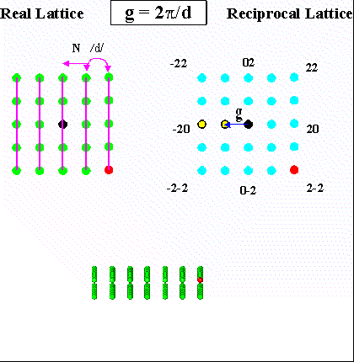
16/07/2018
S. Lodha

Slide 21
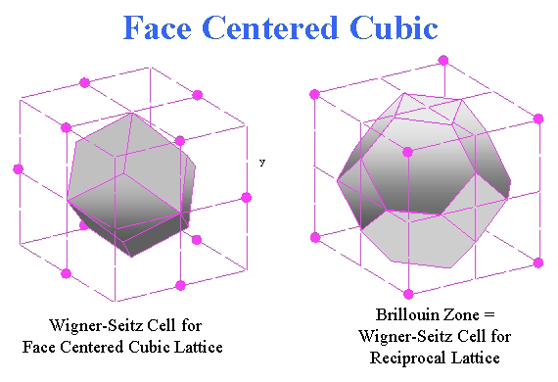
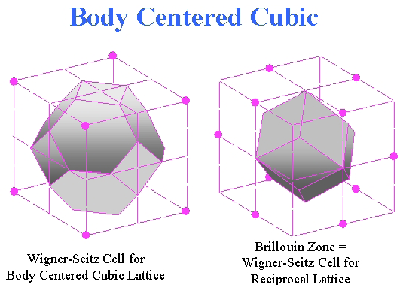
Brillouin Zone
Wigner-Seitz cell of reciprocal lattice is called Brillouin zone
16/07/2018
S. Lodha

Slide 22
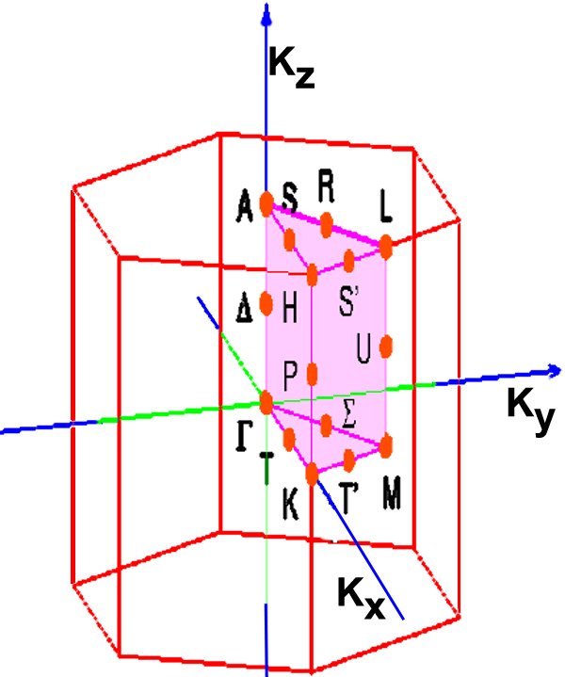
Brillouin Zone for Hexagonal unit cell
16/07/2018
S. Lodha

Slide 23
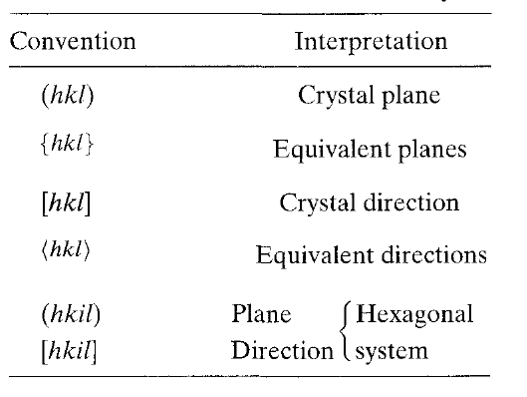

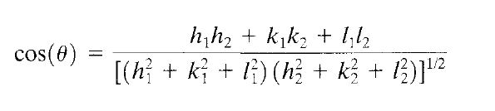
Miller Indices
For cubic crystal systems
A plane and the direction normal to the plane have the same indices in cubic systems
16/07/2018
S. Lodha

Slide 24
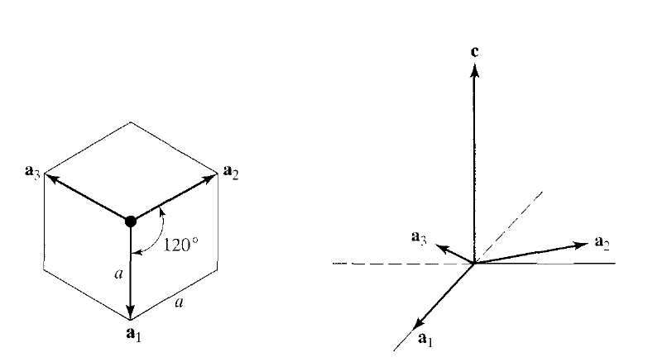
Miller Indices (Hexagonal system)
Four basis vectors chosen for hexagonal systems
  Three non-orthogonal in the base plane of unit cell
  One height basis vector → c
Four indices: [hkil], (hkil)
16/07/2018
S. Lodha

Slide 25
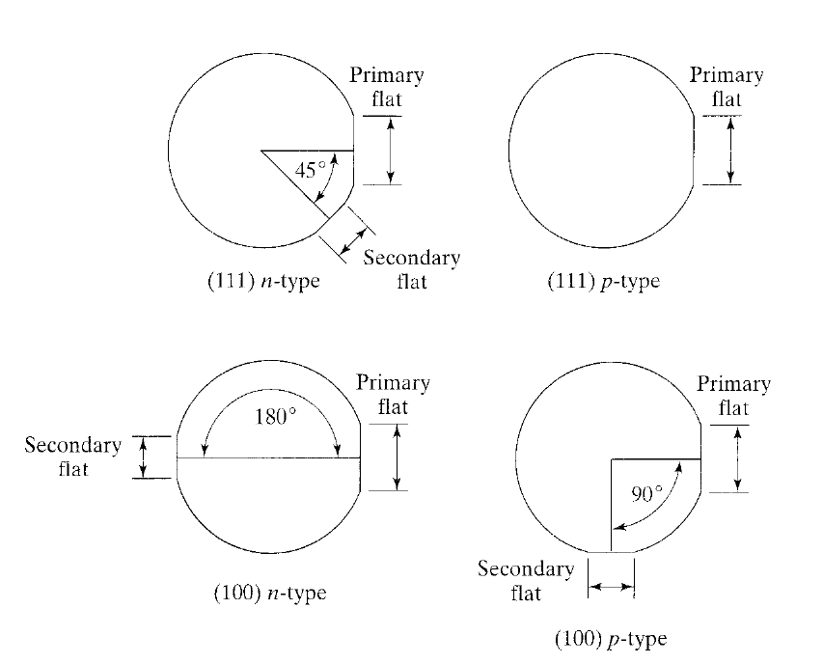
Wafer Flats
Primary flat indicates crystalline directions within the surface
  E.g. primary flat is (011) for (100) wafer => [011] is on the wafer surface, normal to the flat
Positioning of secondary flat w.r.t primary flat indicates wafer type and surface orientation
16/07/2018
S. Lodha

Slide 26

Additional Slides
16/07/2018
S. Lodha

Slide 27
The concept of a family of directions
A set of directions related by symmetry operations of the lattice or the crystal is called a family of directions
A family of directions is represented (Miller Index notation) as: <u v w>
Hence one has to ask two questions before deciding on the list of the members of a family:
1➢ Is one considering the lattice or the crystal?
2➢ What is the crystal system one is talking about
(and what are its symmetries; i.e. point group)?
Miller indices for a direction in a lattice versus a crystal
We have seen in the chapter on geometry of crystals that crystal can have symmetry equal to or lower than that of the lattice.
If the symmetry of the crystal is lower than that of the lattice then two members belonging to the same family in a lattice need not belong to the same family in a crystal → this is because crystals can have lower symmetry than a lattice
(examples which will taken up soon will explain this point).
16/07/2018
S. Lodha

Slide 28


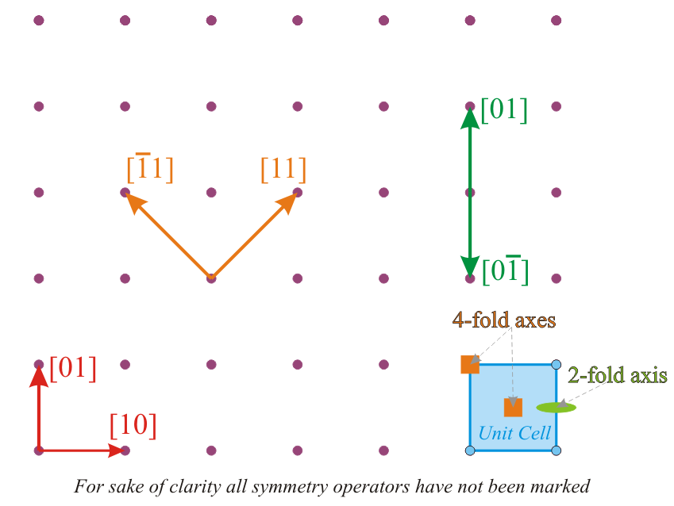


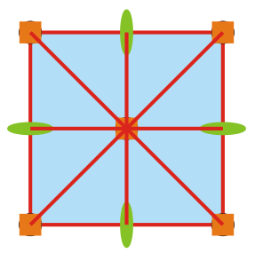
Family of directions
Examples
Let us consider a square lattice:
[10] and [01] belong to the same family → related by a 4-fold rotation
[11] and belong to the same family → related by a 4-fold rotation
➢ [01] and belong to the same family → related by a 2-fold rotation
(or double action of 4-fold)
Writing down all the members of the family
Essentially the 1st and 2nd index can be interchanged and be made negative (due to high symmetry)
16/07/2018
4mm
S. Lodha

Slide 29

Family of directions
Index | Members in family for cubic lattices | Number
<100> |  | 3 x 2 = 6
<110> |  | 6 x 2 = 12
<111> |  | 4 x 2 = 8
the ‘negatives’ (opposite direction)
Symbol | Alternate symbol
[ ] |  | → | Particular direction
< > | [[ ]] | → | Family of directions
16/07/2018
S. Lodha

Slide 30
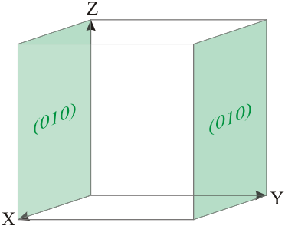
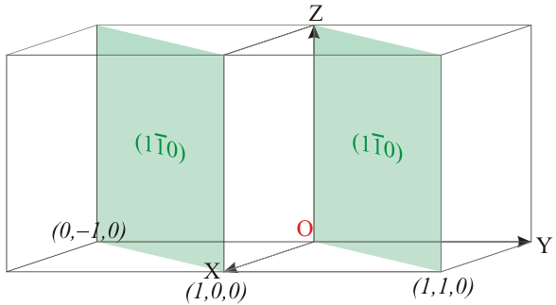
Funda Check
What about the plane passing through the origin?
Plane passing through origin
Plane passing through origin
Intercepts → ∞ 0 ∞
Plane → (0 ∞ 0)
Hence use this plane
Intercepts → 0 0 ∞
Plane → (∞ ∞ 0)
We want to avoid infinities in Miller indices
In such cases the plane is translated by a unit distance along the non zero axis/axes and the Miller indices are computed
16/07/2018
S. Lodha

Slide 31
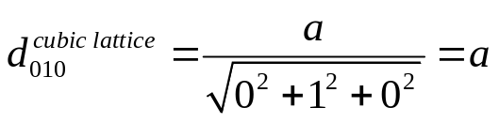
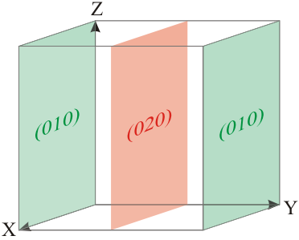
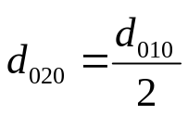
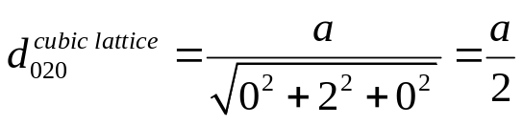
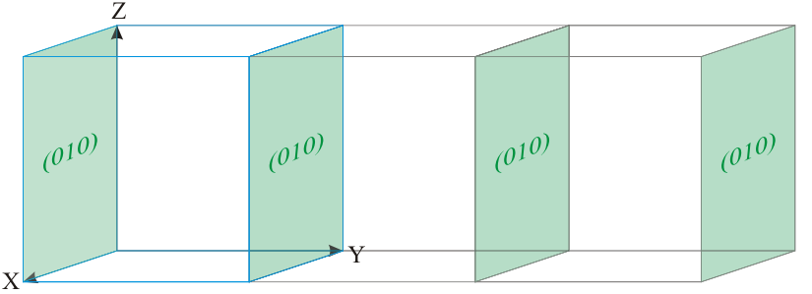
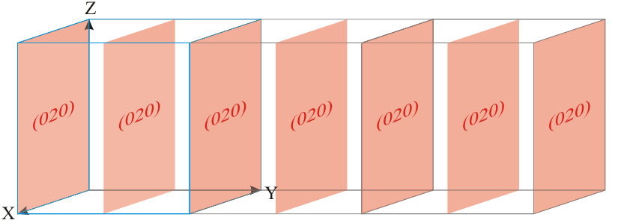
Funda Check
What about planes passing through fractional lattice spacings?
(We will deal with such fractional intersections with axes in X-ray diffraction).
(020) has half the spacing as (010) planes
Actually (020) is a superset of planes as compared to the set of (010) planes
Intercepts → ∞ ½ ∞
Plane → (0 2 0)
Note: in Simple cubic lattice this plane will not pass through lattice points!! But then lattice planes have to pass through lattice points!
Why do we consider such planes? We will stumble upon the answer later.
16/07/2018
S. Lodha

